Slide 1
Ulwazi mayelana nezindlela zokuvikela igciwane lesandulela ngculazi

Slide 2
Izindlela zokuvikela igciwane lesandulela ngculazi
Ziningi izinto ongazenza ukunciphisa ubungozi begciwane lesandulela ngculazi kuwena nomaqondana wakho.
Abeluleki bafuna ukukusiza ukuthi uqonde zonke lezindlela ezilandelayo zokuvikela igciwane lesandulela ngculazi ukuze ukhethe ukuthi iziphi izindlela ezizokusebenzela kangcono.

Slide 3
Ucwaningo lukhombise ukuthi iringi yedapivirine yesitho sowesifazane sangasese sangaphambili inganciphisa amathuba okutheleleka kwabesifazane ngegciwane lesandulela ngculazi. Ukuvikeleka ekuthelelekeni ngegciwane lesandulela ngculazi kubasezingeni eliphakeme kakhulu uma iringi isetshenziswa zikhathi zonke.
Sebenzisa iringi yedapivirine yesitho sowesifazane sangasese sangaphambili ngasosonke isikhathi

Slide 4
Sebenzisa amakhondomu
ngasosonke isikhathi
Sebenzisa ikhondomu ngendlela okuyiyo ngasosonke isikhathi uma wenza ucansi lwesitho sangasese sangaphambili sowesifazane, olwesitho sangasese sangemuva kanye nolomlomo.
Notes:
Bheka ingemuva lalelipheshana ngolwazi olwengeziwe ngamakhondomu.

Slide 5
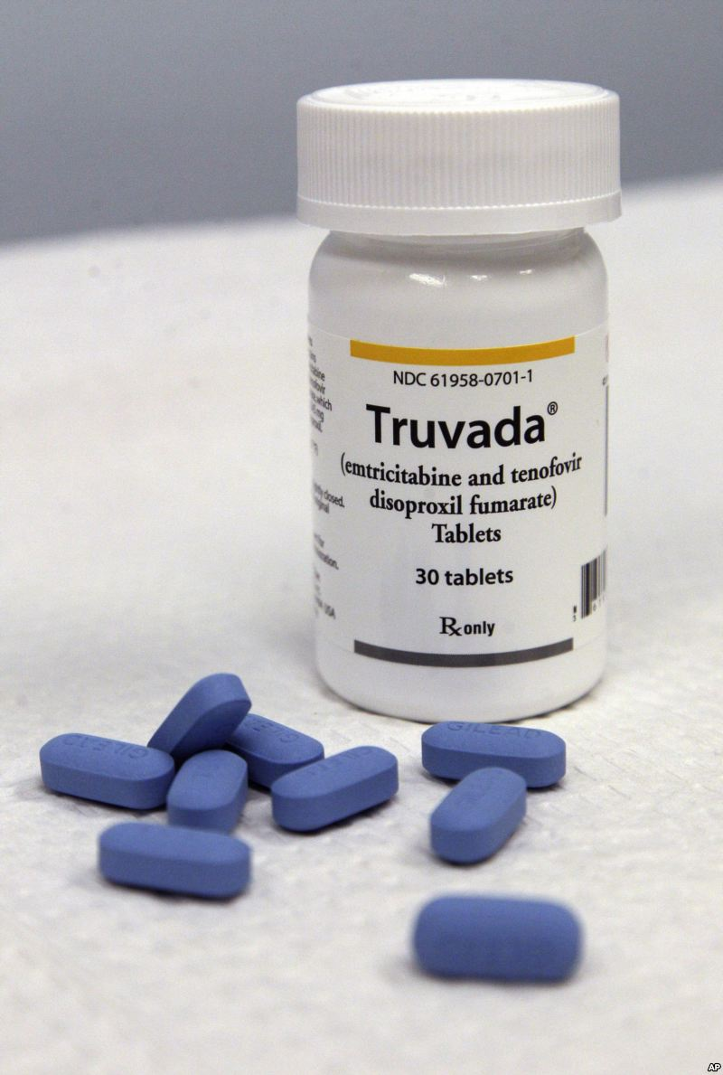
Sebenzisa iPrEP ephuzwayo (e.g. Truvada)
I-PrEP ephuzwayo iyindlela yokuvikela igciwane lesandulela ngculazi kubantu abangenalo igciwane lesandulela ngculazi kodwa abasengcupheni enkulu yokutheleleka ngegciwane lesandulela ngculazi.
I-PrEP ephuzwayo ibandakanya ukuthatha imishanguzo ethize yegciwane lesandulela ngculazi zonke izinsuku.
I-PrEP ephuzwayo ingatholakala noma ingangatholakala emphakathini wakho.
Notes:
Uma kuzwakala njengendlela ongathanda ukuyisebenzisa, khuluma nabasebenzi baseklinikhi ngokuthi iyatholakala yini endaweni yangakini.

Slide 6
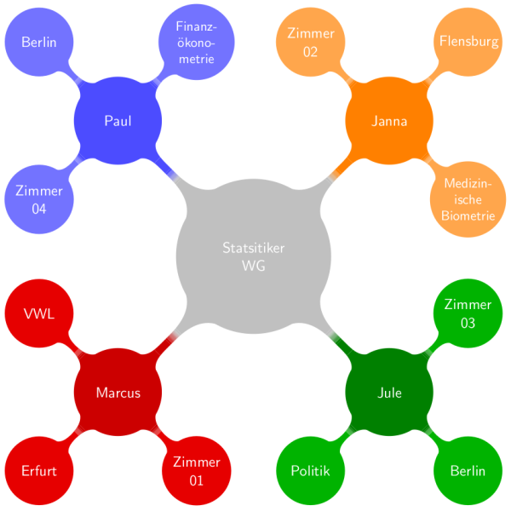
Nciphisa isibalo somaqondana bakho bocansi
Notes:
Uma uba nomaqondana abaningi, kwenza abe maningi amathuba okuthi ube nopmaqondana one gciwane lesandulela ngculazi. Uma umaqondana wakho enomaqondana abaningi, mugqugquzele naye ukuthi anciphise lesisibalo futhi. Kuzokwehlisa ubungozi bokutheleleka ngegciwane lesandulela ngculazi kunina nonke.

Slide 7
Zibandakanye ezenzweni zocansi olungenabunozi
Ucansi lomlomo lunobungozi obuphansi kakhulu kunocansi lwesitho sangasese sangaphambili sowesifazane noma ucansi lwesitho sangasese sangemuva.
Abantu abaningi bacabanga ukuthi ucansi lwesitho sangasese sangemuva luyindlela ephephile, kodwa empeleni kuwuhlobo locansi elunobungozi kakhulu ekudluliseleni gciwane lesandulela ngculazi.

Slide 8
Uma unesifo esithelelanayo ngokocansi (STI), thola ukwelashwa
Ukuba nesifo esithelelanayo ngocansi kungenyusa ubungozi bokutheleleka ngegciwane lesandulela ngculazi noma ukulisabalalisa kwabanye. Gcizelela ukuthi omaqondana bakho bahlolwe futhi belashwe.

Slide 9
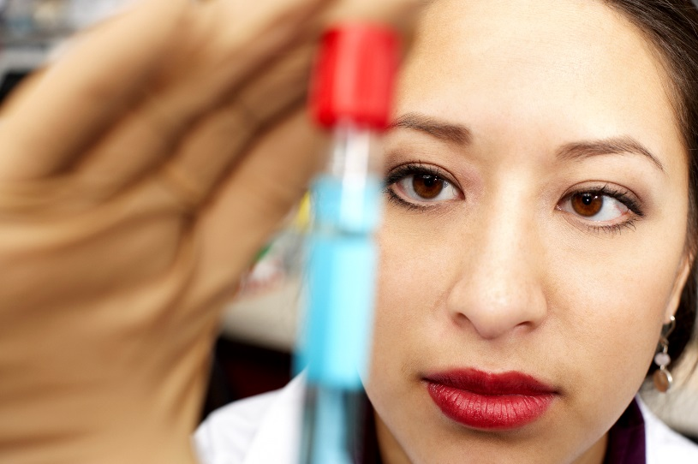
Gqugquzela umaqondana wakho ukuba ahlolelwe igciwane lesandulela ngculazi
Khuluma nomaqondana wakho ngokuhlolela igciwane lesandulela ngculazi bese niyahlolwa ngaphambi kokuba nenze ucansi. Ukwazi ukuthi umaqondanda wakho uthelelekile ngegciwani lesandulela ngculazi kungakusiza ukuba uthathe isinqumo ukuthi iziphi izindlela zokuvikela ezingase zikusebenzele kangcono.

Slide 10
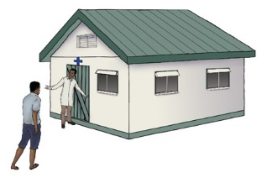
Gqugquzela umaqondana wakho ukuba ayosokwa
Abesilisa abasokiwe basethubeni elihlile ukuba bathole igciwane lesandulela ngculazi kunabesilisa abangasokiwe.
Ukusokwa kwabesilisa akubavikeli abesifazane ekutholeni igciwane lesandulela ngculazi.

Slide 11
Uma umaqondana wakho enegciwane lesandulela ngculazi, mugqugquzele ukuba alandele imigomo ekusebenziseni imishanguzo yakhe yegciwane lesandulela ngculazi
Notes:
Ukwelashwa ngemishanguzo yegciwane lesandulela ngculazi (ebizwa ngama antiretroviral therapy noma kafushane ART) kusiza abantu abanegciwane lesandulela ngculazi ukuba baphile isikhathi eside, nokuphila ngendlela enempilo. Ama-ART awakwelaphi ukutheleleka ngegciwane lesandulela ngculazi, kodwa anganciphisa inani legciwani lesandulela ngculazi emzimbeni. Ukuba negcuwani lesandulela ngculazi elincane emzimbeni kunciphisa ubungozi bukamaqondana wakho ekudluliseni igciwane lesandulela ngculazi ngesikhathi kwenziwa ucansi.

Slide 12
Nakuba zonke izindlela zingeke zikwazi ukuvuna bonke abesifazane, ukwanda kwalezinto ongazenza, ukwanda kokuncipha kwethuba lokuthola igciwane lesandulela ngculazi.

Slide 13
Ulwazi olwengeziwe mayelana namakhondomu:
Amakhondomu avikela ungatheleleki ngegciwane lesandulela ngculazi ngokocansi lwesitho sowesifazane sangasese sangaphimbili kanye nocansi lwesitho sangasese sangemuva.
Iringi-yedapivirine inciphisa ubungozi bokuthola igciwane lesandulela ngculazi ngocansi lwesitho sangasese sangaphambili sowesifazane.
Iringi ayakhelwanga ukuvikela ekuthelelekeni ngegciwane lesandulela ngculazi ngocansi lwesitho sangasese sangemuva futhi akufanele isetshenziswe ngokwangemuva

Slide 14
Ulwazi olwengeziwe mayelana namakhondomu:
Amakhondomu avikela ukukhulelwa kanye nezinye izifo ezithelelana ngokocansi.
Notes:
Ngaphezu kokuvikela kwigciwane lesandulela ngculazi, amakhondomu anezinye izinzuzo zezempilo.

Slide 15
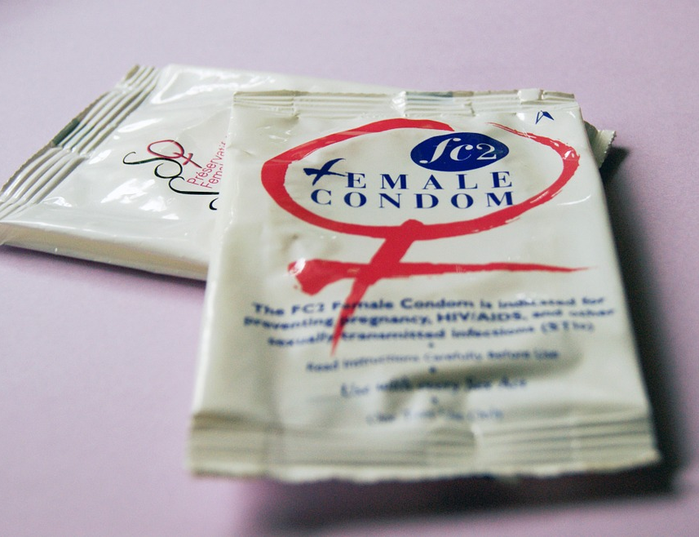
Ulwazi olwengeziwe mayelana namakhondomu:
Uma esetshenziswa njalo ngendlela, amakhondomu e-latex ayindlela engcono kakhulu kuvikela kwezinye izifo ezithelelana ngokocansi njenge gonorrhoea, chlamydia, noma trichomonas.
Notes:
Ngaphezu kokuvikela kwigciwane lesandulela ngculazi, amakhondomu anezinye izinzuzo zezempilo.
Ezinye izithandani zikhetha amakhondomu njengendlela yokuhlela umndeni ukuvikela ukukhulelwa okungahlosiwe.

Slide 16
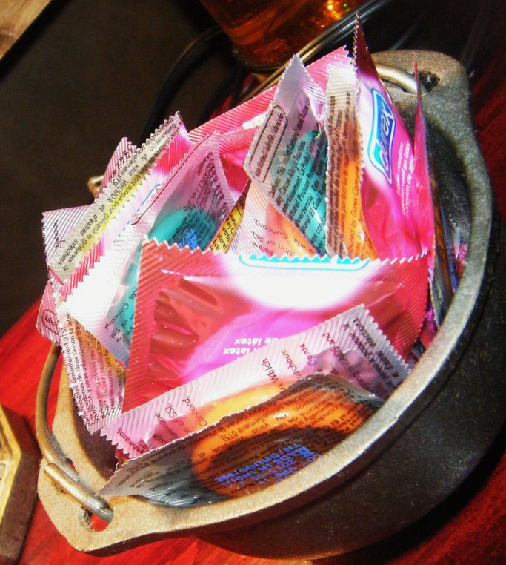
Angasetshenziswa kanjani ngendlela nangezikhathi zonke amakhondomu:
Sebenzisa ikhondomu entsha ngesenzo ngasinye socansi (lomlomo, lwesitho sangasese sowesifazane sangaphambili kanye nolwesitho sangasese sangemuva).

Slide 17
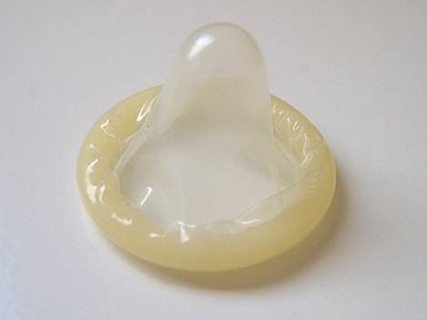
Angasetshenziswa kanjani ngendlela nangezikhathi zonke amakhondomu:
Liphathe kahle ikhondomu ukugwema ukulilimaza ngezinzipho, amazinyo, kanye nezinye izinto ezicijile.
Faka ikhondomu emva kokuba isitho sangasese sangaphambili sowesilisa sesivukelwe nangaphambi kwanoma ikuphi ukuthintana ngezitho zangasese, umlomo, noma isitho sangasese sangemuva nomaqondana wakho.

Slide 18
Angasetshenziswa kanjani ngendlela nangezikhathi zonke amakhondomu:
Qinisekisa ukuthi ubumanzi banele ngesikhathi wenza ucansi lwesitho sowesifazane sangasese sangaphambili kanye nocansi lwesitho sangasese sangemuva, kodwa sebenzisa isithambisi esinesisekelo samanzi (njenge K-Y Jelly) kanye namakhondomu e-latex.
Izithambisi ezinesisekelo samafutha (njengoVaseline noma iloshini yomzimba) kungawalimaza amakhondomu.

Slide 19
Angasetshenziswa kanjani ngendlela nangezikhathi zonke amakhondomu:
Ukugwema ikhondomu ukuthi lishibilike liphume, libambe liqine emsukweni wesitho sowesilisa sangasese sangaphambili ngesikhathi ukhipha, bese ukhipha isitho sowesilsa sangasese sangaphambili ngesikhathi sesivukelwe.

Slide 20
Uma unemibuzo noma udinga ulwazi olwengeziwe, sicela uvakashele eklinikhi yocwaningo.

